Slide 1


Breast Cancer Analytics: Leveraging Big Data for Deeper Insights
Presented By: Vipin Kumar (Roll No: 24MBMB13) - MBA Business Analytics, University of Hyderabad
This capstone project explores the power of Big Data, Text, Social Media, and Web Analytics to uncover critical patterns and sentiments surrounding breast cancer.

Slide 2
Project Overview: Unpacking Breast Cancer Narratives
This project uses Big Data, NLP, Social Media, Web Analytics, and Machine Learning to gain comprehensive insights into public awareness, patient emotions, and online engagement regarding breast cancer.
Key Areas of Analysis
Understanding public awareness and sentiments
Analyzing search behavior and online engagement
Providing a multi-faceted view of the digital footprint
Dataset Snapshot
We analyzed a synthetic dataset of 350 rows, including:
Tweet text and engagement metrics
Article text for topic modeling
Patient support group posts
Google search index data
YouTube comments and video engagement
Key Tools & Techniques
Data Processing: PySpark, Pandas, NLTK
NLP Models: TF-IDF, LDA, VADER Sentiment, NRC Emotion Lexicon
Machine Learning: Random Forest, Logistic Regression, Ridge Regression
Visualization: Matplotlib 2D/3D

Slide 3
Social Media Sentiment Analysis
We analyzed breast cancer awareness tweets to gauge public sentiment and identified key insights into online discussions.
Objective
Methodology
Assess public sentiment on breast cancer awareness tweets.
VADER sentiment scoring, Logistic Regression, Random Forest.
56.5%
58.0%
Logistic Reg. Accuracy
Random Forest Accuracy
Key Insight: Sentiment is generally neutral-positive, though text variability limits prediction accuracy.

Slide 4


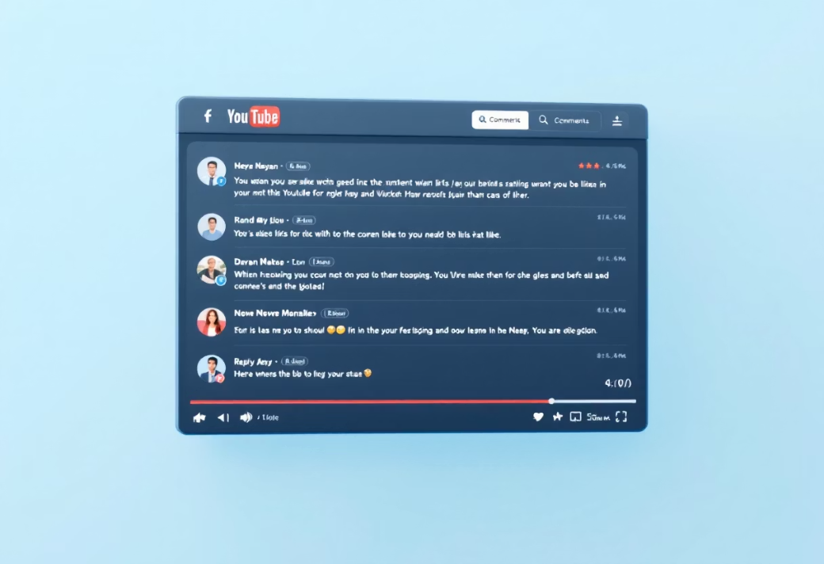
Deeper Dives: Emotions, Trends & Engagement
Use Case 3: Emotion Detection
Use Case 4: Web Search Trend Analysis
Use Case 5: YouTube Comment Analytics
Goal: Identify emotions in patient support group posts.
Goal: Analyze Google search interest for breast cancer.
Goal: Predict engagement from comment text.
Method: NRC Emotion Lexicon.
Method: Time-series analysis, rolling averages.
Method: Ridge Regression (VADER sentiment, TF-IDF features).
Insight: High occurrences of fear & sadness, highlighting need for emotional support.
Insight: Seasonal pattern, peaking every October (Breast Cancer Awareness Month).
Insight: Emotion-rich comments significantly impact engagement.
Metrics: Accuracy: 0.58, ROC-AUC: 0.583.

Slide 5


Conclusion: Key Insights & Future Directions
Future Scope
Key Insights
Public sentiment is mixed, but positive messaging boosts engagement.
Topic modeling confirms a strong focus on screening & awareness.
Patient posts reveal high fear/sadness, emphasizing emotional support needs.
Web search trends show predictable seasonal awareness cycles.
YouTube engagement is driven by sentiment and meaningful comment text.
Develop real-time dashboards with Spark Streaming.
Expand to multimodal analytics (text, images, video).
Integrate deep learning models (BERT, LSTM) for enhanced NLP.
Incorporate hospital data for personalized risk prediction.
Thank You!

